Slide 1
From 0 to Cloud Scale
Daniel Larsen
Premier Field Engineer, Microsoft
dalars@microsoft.com
@DanielLarsenNZ
Vishesh Oberoi
Technical Evangelist, Microsoft
Vishesh.Oberoi@microsoft.com
@ovishesh

Slide 2
The changing world of app development
Mainframe
Monolithic
Client/Server
3 Tier
Component
RAD
Distributed
SOAP
SOA
Web
Physical Machines
Virtual Machines
Cloud Infrastructure
Born in the Cloud
REST
Mobile
Microservices
Build on a developer platform (PaaS + Serverless)
Containers
Serverless
1990
2000
2010
2016
Notes:
[Speaker Guidance: This section is a history lesson. Don’t spend much time here. Key message is that PaaS moves beyond cloud-hosted VMs, because the underlying OS doesn’t need to be managed, nor does scalability, most security, and other key attributes.]
Objective:
Illustrate the computing “eras” that have led to the cloud overlaid with some of the common app design paradigms that developers have employed to constantly strive for greater speed, efficiency and productivity.
Key talking points:
In the beginning, there were physical machines. They were expensive and developers loaded them up with multiple applications to save costs. This caused no end of conflicts and unexpected bugs, yet effective machine utilization was still low. Developers struggled to make sure changes to one application didn’t break an unrelated application.
Next up: virtual machines. Since multiple VMs could be run on a single physical box, developers installed their applications in contained VMs, which reduced conflicts and improved utilization, but welcome to shared memory and unpredictable performance. And since provisioning had to be made for the largest loads, “scaling in” wouldn’t really save money.
Enter the cloud. Companies could rent the virtual machines they needed, when they needed them. They could scale applications up and down on demand. You still needed to install and configure OS level patches and updates, and you still had to contend with low-level networking.
But most of the benefits of this model accrued to operations and infrastructure, not app development.
In a new Evans Data survey of 1,441 developers, 81.3% of respondents said they plan to build applications in the cloud within the next 24 months.

Slide 3
From IaaS to FaaS
IaaS
CaaS
PaaS
FaaS
Functions
Functions
Functions
Functions
Customer Managed
Application
Application
Application
Application
Customer Managed Unit of Scale
Runtime
Runtime
Runtime
Runtime
Abstracted by Vendor
Containers (optional)
Containers
Containers
Containers
Operating System
Operating System
Operating System
Operating System
Virtualization
Virtualization
Virtualization
Virtualization
Hardware
Hardware
Hardware
Hardware

Slide 4




The evolution of deployment speed Speed enables and encourages new microservice architectures
Datacenters
Virtualization
Containers
Serverless
Months to deploy, live for years
Minutes to deploy, live for weeks
Seconds to deploy, live for minutes/hours
Milliseconds to deploy, live for seconds
Source: http://www.slideshare.net/adriancockcroft/dockercon-state-of-the-art-in-microservices
thenewstack.io

Slide 5
Why the cloud?
Speed
Scale
Economics
Notes:
So in a nutshell Cloud is all about:
Speed - Rapidly setup environments to drive business priorities
Scale - Scale to meet peak demands
Economics - Increase daily activities, efficiency and reduced cost.

Slide 6

Mobile first + Cloud first

Slide 7

Multi-device
Artificial Intelligence
Intelligent Cloud
Serverless
Intelligent Edge

Slide 8
Any developer Any app Any platform

Slide 9
Any developer Any app Any platform
VISUAL STUDIO
ASP.NET
AZURE LINUX VM
VISUAL STUDIO CODE
C#
iOS DEVICE
XAMARIN STUDIO
C++
AZURE WINDOWS VM
EMACS
NODE.JS
ANDROID DEVICE
VIM
PYTHON
AZURE CONTAINER SERVICE
VISUAL STUDIO
HTML/JS
WINDOWS DEVICE
VISUAL STUDIO CODE
ASP.NET
AZURE WEB APP
XAMARIN STUDIO
C#
AZURE LINUX VM
EMACS
C++
iOS
DEVICE
VIM
NODE.JS
AZURE WINDOWS VM
PYTHON
ANDROID DEVICE
HTML/JS
AZURE CONTAINER SERVICE
WINDOWS DEVICE
AZURE WEB APP

Slide 10
Any developer Any app Any platform
ASP.NET
AZURE LINUX VM
VISUAL STUDIO
C#
iOS DEVICE
VISUAL STUDIO CODE
C++
AZURE WINDOWS VM
XAMARIN STUDIO
NODE.JS
ANDROID DEVICE
EMACS
PYTHON
AZURE CONTAINER SERVICE
VIM
HTML/JS
WINDOWS DEVICE
VISUAL STUDIO
ASP.NET
AZURE WEB APP
VISUAL STUDIO
ASP.NET
AZURE WEB APP
VISUAL STUDIO CODE
C#
AZURE LINUX VM
XAMARIN STUDIO
C++
iOS
DEVICE
EMACS
NODE.JS
AZURE WINDOWS VM
VIM
PYTHON
ANDROID DEVICE
HTML/JS
AZURE CONTAINER SERVICE
WINDOWS DEVICE
AZURE WEB APP

Slide 11
Any developer Any app Any platform
VISUAL STUDIO
AZURE LINUX VM
VISUAL STUDIO CODE
iOS DEVICE
XAMARIN STUDIO
AZURE WINDOWS VM
EMACS
ASP.NET
ANDROID DEVICE
VIM
C#
AZURE CONTAINER SERVICE
VISUAL STUDIO
C++
WINDOWS DEVICE
VISUAL STUDIO
CODE
NODE.JS
AZURE WEB APP
VISUAL STUDIO CODE
NODE.JS
AZURE WEB APP
XAMARIN STUDIO
PYTHON
AZURE LINUX VM
EMACS
HTML/JS
iOS
DEVICE
VIM
ASP.NET
AZURE WINDOWS VM
C#
ANDROID DEVICE
C++
AZURE CONTAINER SERVICE
NODE.JS
WINDOWS DEVICE
PYTHON
AZURE WEB APP
HTML/JS

Slide 12
Any developer Any app Any platform
VISUAL STUDIO
AZURE LINUX VM
VISUAL STUDIO CODE
iOS DEVICE
XAMARIN STUDIO
AZURE WINDOWS VM
EMACS
ASP.NET
ANDROID DEVICE
VIM
C#
AZURE CONTAINER SERVICE
VISUAL STUDIO
C++
WINDOWS DEVICE
VISUAL STUDIO
C++
WINDOWS DEVICE
VISUAL STUDIO CODE
NODE.JS
AZURE WEB APP
XAMARIN STUDIO
PYTHON
AZURE LINUX VM
EMACS
HTML/JS
iOS
DEVICE
VIM
ASP.NET
AZURE WINDOWS VM
C#
ANDROID DEVICE
C++
AZURE CONTAINER SERVICE
NODE.JS
WINDOWS DEVICE
PYTHON
AZURE WEB APP
HTML/JS

Slide 13
Any developer Any app Any platform
AZURE LINUX VM
ASP.NET
iOS DEVICE
C#
AZURE WINDOWS VM
VISUAL STUDIO
C++
ANDROID DEVICE
VISUAL STUDIO CODE
NODE.JS
AZURE CONTAINER SERVICE
XAMARIN STUDIO
PYTHON
WINDOWS DEVICE
EMACS
HTML/JS
AZURE WEB APP
VIM
ASP.NET
AZURE LINUX VM
VISUAL STUDIO
C#
iOS DEVICE
VISUAL STUDIO
C#
iOS
DEVICE
VISUAL STUDIO CODE
C++
AZURE WINDOWS VM
XAMARIN STUDIO
NODE.JS
ANDROID DEVICE
EMACS
PYTHON
AZURE CONTAINER SERVICE
VIM
HTML/JS
WINDOWS DEVICE
AZURE WEB APP

Slide 14
Any developer Any app Any platform
AZURE LINUX VM
iOS DEVICE
AZURE WINDOWS VM
ASP.NET
ANDROID DEVICE
VISUAL STUDIO
C#
AZURE CONTAINER SERVICE
VISUAL STUDIO CODE
C++
WINDOWS DEVICE
XAMARIN STUDIO
NODE.JS
AZURE WEB APP
EMACS
PYTHON
AZURE LINUX VM
EMACS
PYTHON
AZURE LINUX VM
VIM
HTML/JS
iOS
DEVICE
VISUAL STUDIO
ASP.NET
AZURE WINDOWS VM
VISUAL STUDIO CODE
C#
ANDROID DEVICE
XAMARIN STUDIO
C++
AZURE CONTAINER SERVICE
EMACS
NODE.JS
WINDOWS DEVICE
VIM
PYTHON
AZURE WEB APP
HTML/JS

Slide 15

The Visual Studio Family
Visual Studio
Best-in-class tools for every developer
Visual Studio for Mac
Visual Studio Code
Visual Studio Mobile Center
Visual Studio Team Services
Microsoft Azure

Slide 16
Azure

Slide 17
Choice + Flexibility
Microsoft Azure
Enterprise Ready
Productivity

Slide 18
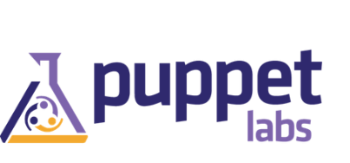










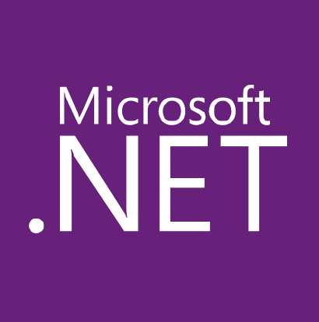














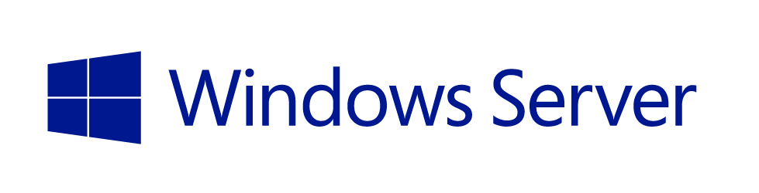
DevOps
Applications
Choice + Flexibility
App Frameworks
Databases & Middleware
Infrastructure

Slide 19

38
Azure regions around the world
More than AWS and Google Cloud combined

Slide 20
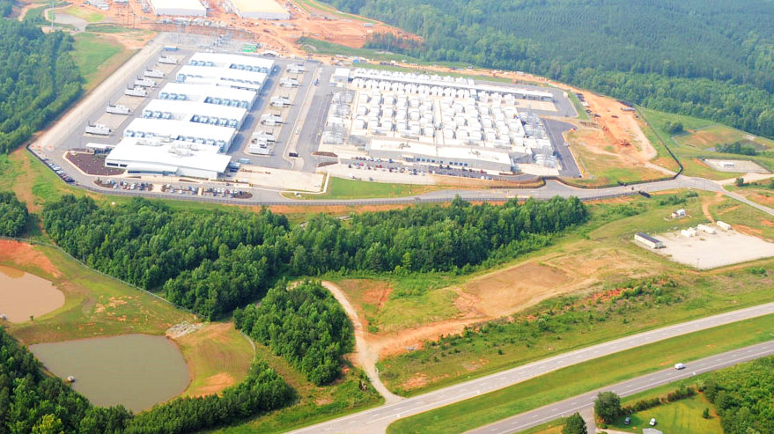

Slide 21


Slide 22
Platform services
Web + Mobile Internet of Things
Microservices
Data + Analytics
Identity Management
Media Streaming
High Performance Compute
Cognitive Services
Microsoft Azure
Hybrid
Core infrastructure
Compute Storage Networking Security

Slide 23


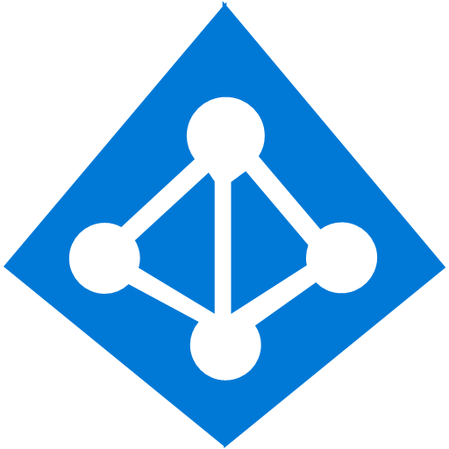









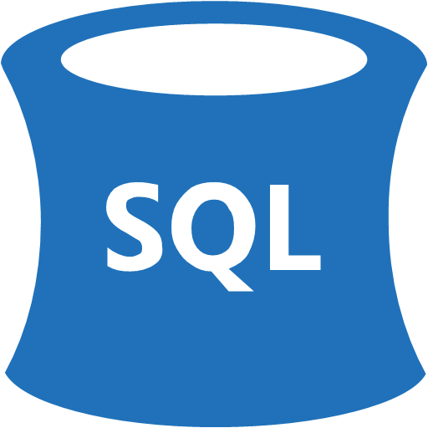





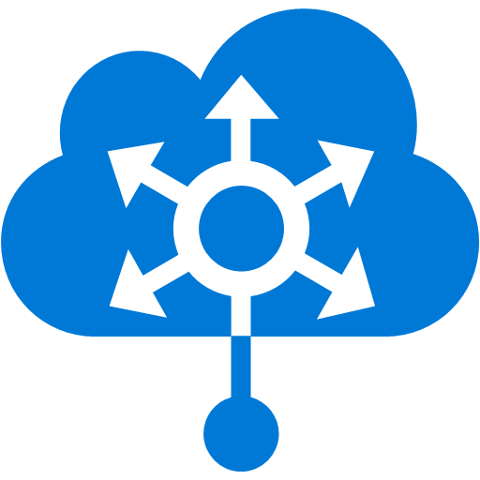



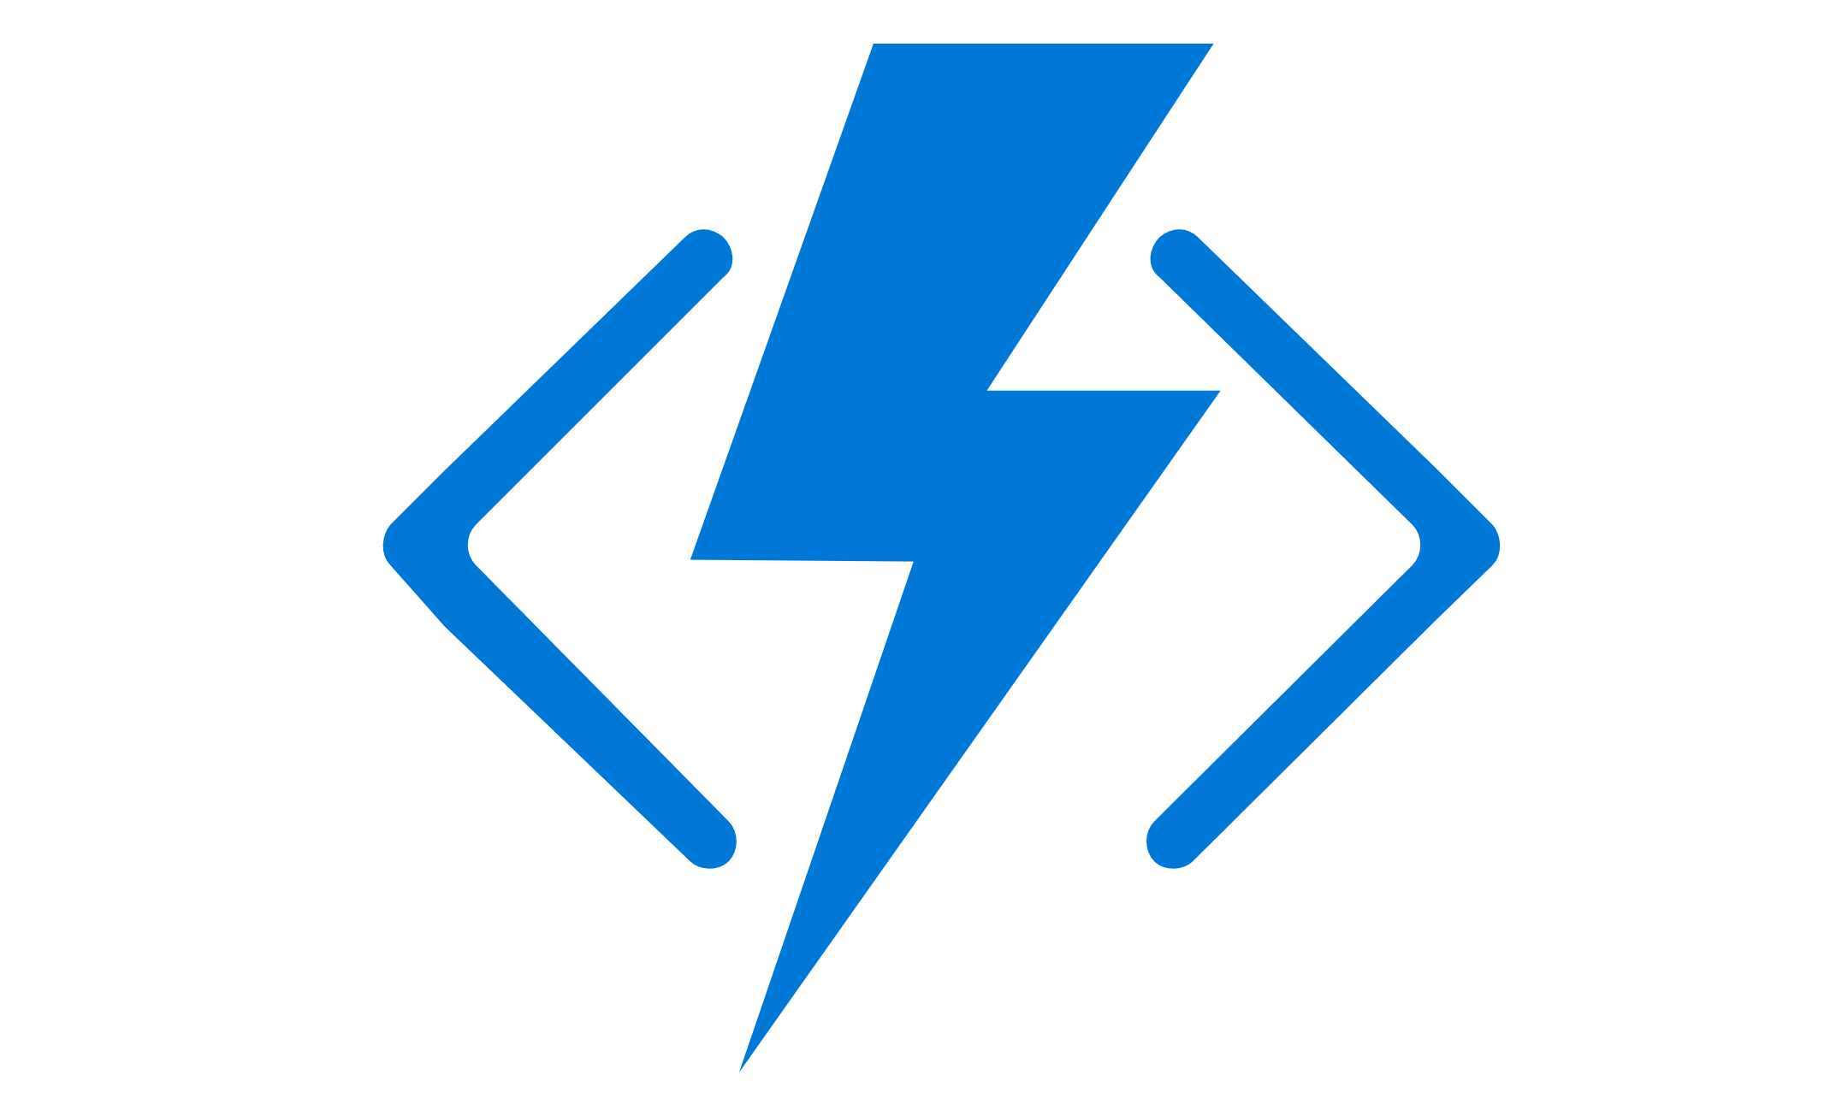



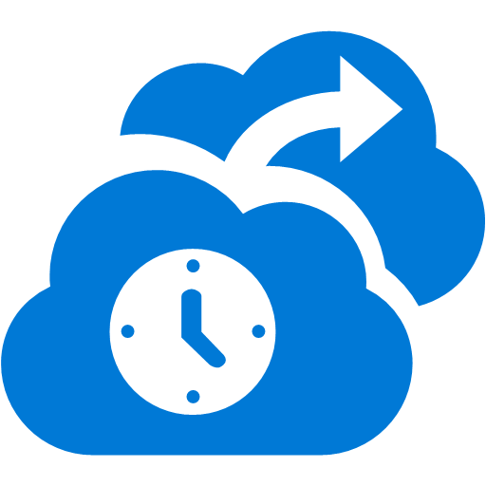







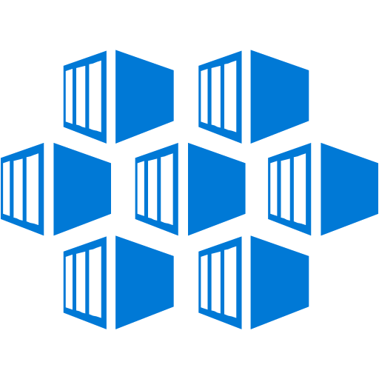

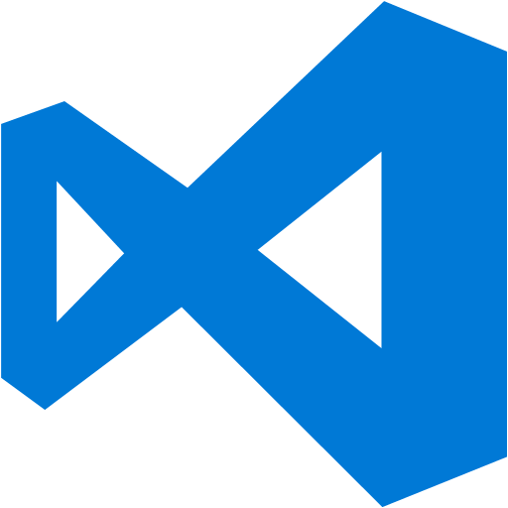




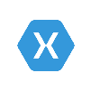















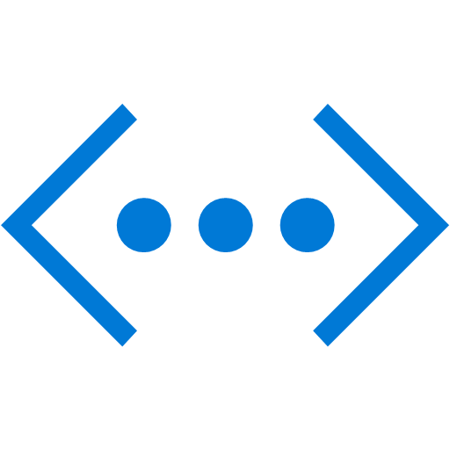


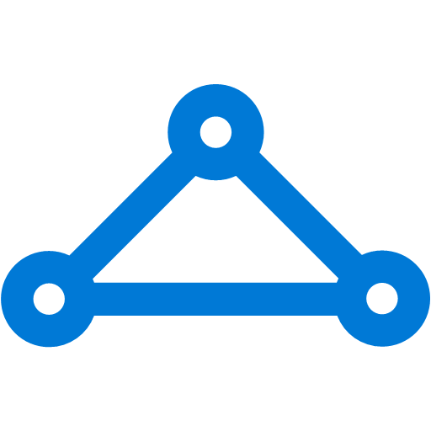



Platform Services
Security & Management
Hybrid
Cloud
Media & CDN
Application Platform
Data
Security Center
SQL
Database
Azure AD
Health Monitoring
Media Services
Media Analytics
Content Delivery
Network
Web
Apps
Mobile
Apps
SQL Data
Warehouse
DocumentDB
Portal
AD Privileged
Identity
Management
Azure Active
Directory
Integration
SQL Server
Stretch Database
Redis
Cache
Storage
Tables
Azure
Search
API
Apps
Cloud
Services
Azure AD
B2C
API
Management
BizTalk
Services
Domain Services
Service
Fabric
Notification
Hubs
Intelligence
Multi-Factor
Authentication
Logic
Apps
Service Bus
Functions
Cognitive Services
Bot Framework
Cortana
Backup
Automation
Developer Services
Analytics & IoT
Operational
Analytics
Compute Services
Scheduler
HDInsight
Machine
Learning
Stream Analytics
Container
Service
VM
Scale Sets
Visual Studio
Mobile
Engagement
Import/Export
Key Vault
Data
Catalog
Data Lake
Analytics Service
Data Lake Store
Store/
Marketplace
Batch
RemoteApp
VS Team Services
Xamarin
Azure Site
Recovery
Application
Insights
HockeyApp
IoT Hub
Event
Hubs
Data
Factory
Power BI
Embedded
VM Image Gallery
& VM Depot
Dev/Test Lab
StorSimple
Infrastructure Services
Compute
Storage
Networking
Virtual Machines
Containers
Blob
Queues
Files
Disks
Virtual Network
Load Balancer
DNS
Express
Route
Traffic Manager
VPN Gateway
App
Gateway
Datacenter Infrastructure (32 Regions, 24 Online)
Notes:
Why this Slide:
It shows we have a very broad platform. It about BOTH IaaS and PaaS, that these work together. It shows that we continue to lead in world class IT capabilities and that there’s really nothing missing.
Key Points:
We have already seen how the Azure Platform is IaaS + Pass – but I want you to understand that this is a huge number of capabilities – IT building blocks if you will.
Every one of these blocks you provision anytime, self-service anywhere in the world 24x7. You pay for what you use, you can get more or less anytime and you can fully automate everything…
DON’T spent too much time on this slide – you are going to DEMO (aren’t you!!!)… DON’T go through each block…
Transition to NEXT Slide: Make the build go backwards to show JUST IaaS and then you will go to the demo to show it.

Slide 24


Going Digital
1 million/hour
new devices coming online
by 2020
12 years
average age of S&P 500 corporations
by 2020
60% computing
in the public cloud by 2025
Notes:
Why is this transformation important? Let’s take a look at the next few years before us…
In 2020, 1 million new devices are expected to come online every hour. The connectivity between people and data is creating billions of new relationships that are driven not only by data but by algorithms that keep customers engaged and buying.*
In 2020, the average age of a S&P 500 corporation is expected to be 12 years old. Compare that to the S&P 500 in 1960 when the average age was 60 years old.**
By the year 2025, at least 60 percent of computing will be cloud-based, due to “everything-as-a-service” shifting fundamental changes in the IT industry.***
For digital transformation, mobility is the universal catalyst and cloud is the great enabler.
How are you planning for digital transformation? Do you have the right people and the right technology in place to build your digital vision?
How can you use technology to shape your future?
*http://www.gartner.com/newsroom/id/3142917
**http://upstart.bizjournals.com/resources/author/2015/06/04/fortune-500-must-disrupt-or-die-writes-r-ray-wang.html?page=all
***http://www.emersonnetworkpower.com/en-US/Latest-Thinking/Data-Center-2025/Documents/002401_DataCenter2025Report_HR_INTERACTIVE.PDF

Slide 25




Microsoft Azure
Leading the journey to the Cloud
Developer + App Platform
App Platform Services
Integration
Development Tools
Media & CDN
SAAS Solutions
Microsoft Dynamics
Content Delivery Network
App Service
Storage Queues
Visual Studio
Microsoft Azure
Notification Hubs
BizTalk Services
Visual Studio Online
Media Services
Enterprise Mobility
Microsoft Enterprise Mobility Suite
Developer + App Platform
Visual Studio Family + Azure App Service
API Management
Hybrid Connections
Application Insights
Cortana Analytics Suite
Data + Analytics
Service Fabric
Service Bus
Azure SDK
Cloud Services
Internet of Things
Azure IoT Suite
Cloud Infrastructure
Azure + Azure Stack + Operations Management Suite

Slide 26


Azure App Service Build and scale great Web and mobile apps
Web apps
Mobile apps
Logic apps
API apps
Auto-patching and auto-scale
.NET, Java, Node.js, PHP, Python
Integrate with SaaS and on-premises
Continuous integration with VSTS, Github, BitBucket, and more
Notes:
What are the key things to call out on agility here? Ease of use?
App Service has everything you need to build apps that target both web and mobile clients from a single app back-end.
Using API Apps, you can connect your app to dozens of popular services like Office 365 and salesforce.com in minutes, and integrate your own APIs so they can be used within any app.
And finally with Logic Apps, you can automate business processes using a simple no-code experience.
App Service is the preferred option for building web or mobile applications because it provides the productivity, scale, performance, and deployment options for most requirements. Use App Service when you want to focus on building unique differentiation for your app and need the infrastructure to just work. Additionally, it’s great for building an API layer which can be exposed to customers, partners and employees securely using the related API Management service. You can use App Service in conjunction with the many other Azure services (Redis Cache or Azure Traffic Manager for instance) to build and deploy powerful apps quickly.
Perhaps mention Yochay’s session on Friday

Slide 27
Develop apps with…
.NET | Node.js | PHP | Python | Java

Slide 28
Benefits of App Services
Automatic OS patching
Enterprise-grade security
High availability
Automated scale out/in
Built-in load balancing
Supports many languages and platforms
.NET, Node.js, Python, Ruby and many more
Easy continuous deployment
Continuous delivery from third-party source control providers
Built-in Git repo

Slide 29



Web Apps
Logic Apps
Mobile Apps
Administration App
Customer site
Order Completed
Customer App
http
SQL
API Apps

Slide 30
Continous Delivery with App Service

Slide 31
Continuous integration

Slide 32

Source Control for Web/API/Mobile Apps
Git
Visual Studio
Online
CodePlex
GitHub
BitBucket
DropBox
FTP
Choose your own adventure!
Notes:
Slide Objectives:
Objective #1
Transition:
Transition statement(s) to setup the slide
Speaking Points:
Speaking Point #1
Speaking Point #2
Notes:
Any notes go here

Slide 33
AutoScale

Slide 34

AutoScale
Web App

Slide 35
AutoScale
Web App

Slide 36
AutoScale
Web App

Slide 37
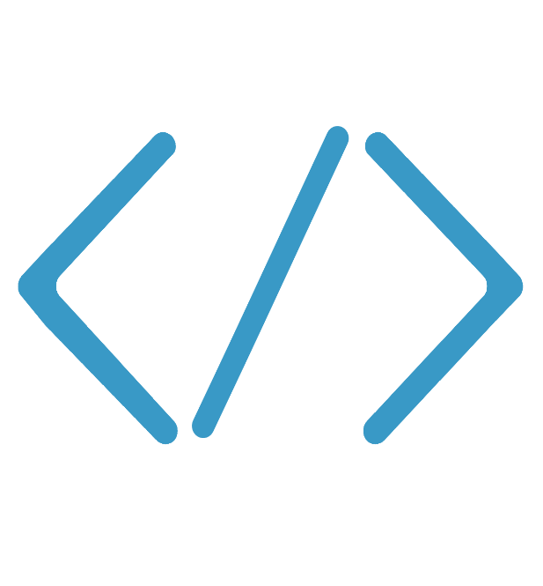
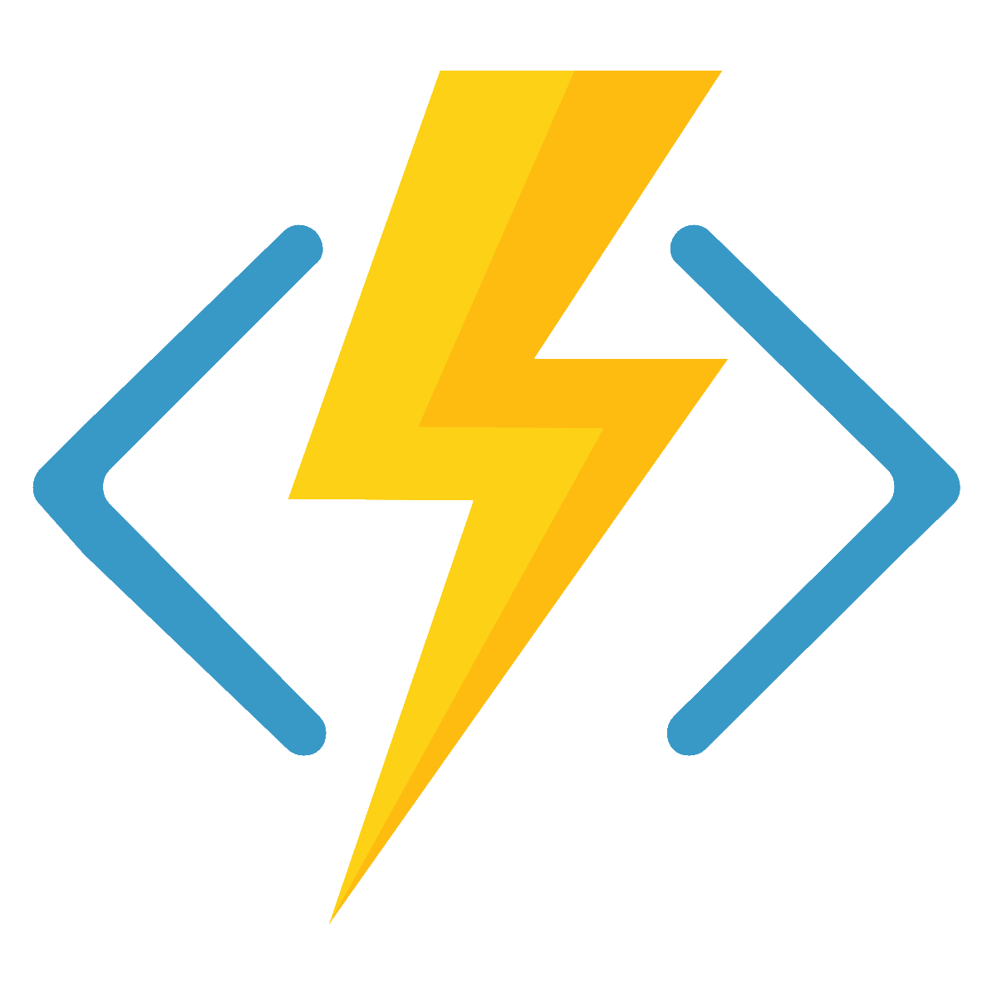

What is Azure Functions?
Code
Azure Functions
Events + data

Slide 38
Respond to any event
Develop your way
Integrated DevOps
Pay for what you use
Fully open source
Azure Functions
Notes:
Azure Functions has now entered public preview. Azure Functions offers a serverless, microcompute, event-driven service with full Azure platform integration that extends the existing Azure application platform with capabilities to implement code triggered by events occurring in other Azure services, SaaS products, and on-premises systems:
Respond to any event: Azure Functions extends Azure’s market leading PaaS platform, extending the existing WebJobs infrastructure to let developers easily implement code that reacts to events generated from across the breadth of Azure. Whether you want to respond to changes in Azure storage containers, events emitted in SaaS products that support Web Hooks, or by calls to an HTTP endpoint. They're all easy to set up and require minimal configuration.
Develop your way: Implement events in a variety of languages (JavaScript, C#, Python and PHP), as well as scripting options like Bash, Batch, and PowerShell, using an intuitive web based user experience or upload and trigger pre-compiled executables built in the development tool of your choice.
Integrated DevOps: Quickly and easily iterate on your Azure Functions with continuous deployment using Visual Studio Team Services, GitHub or BitBucket. Monitor and troubleshoot your Azure Functions using the embedded logging environment.
Pay for what you use: With Azure Functions you will only be charged for the time your code is running. When an Azure Function is invoked it will be provided with as many resources as it needs to execute only for as long as it is executing.
Built for the Enterprise: Invoke your functions when events occur in internal APIs or business systems, then output the results to your on-premises databases or business solutions. Make your Azure Functions truly secure by hosting them on an App Service Environment that can be configured to be addressable only from internal networks.
Fully open-source, based upon the Kudu project and with an open source SDK and open source portal experience.
Events happen, all the time. Users browse your website, data is uploaded/downloaded or moved, messages are sent and received. All across the IT landscape actions are creating events, but are you taking full advantage of them? Imagine if you could react to events happening across your app portfolio in real time, what would you do? Maybe a photo gets saved to some storage area, the act of the photo being saved generates an event that could be intercepted to start a process to check the photo for interesting data. It wouldn’t matter how the photo was saved, it just matters that it was. Azure Functions extends Azure’s application platform by offering serverless compute for event-driven solutions. Azure Functions lets developers easily handle tasks that respond to events common in web and mobile applications, IoT and big data scenarios. Azure Functions works with Azure and third party services, automatically scales out to meet demand and only charges for the time your function runs. With an open source runtime, developers will be able host Functions anywhere - on Azure, in your datacenter or on other clouds. Azure Functions allows developers to program functions in JavaScript, C#, Python and PHP or scripting options such as Bash, Batch, and PowerShell using either an intuitive, web-based development environment that allows you to develop directly against your function or by uploading pre-compiled function written in the development tool of your choice. Pre built Input/Output bindings provide a means of pulling or pushing data to many of the most common Azure 3rd party services, saving developers from having to build these bindings themselves. However, the open source nature of Azure Functions allows you to build your own bindings for services not already supported.

